Slide 1

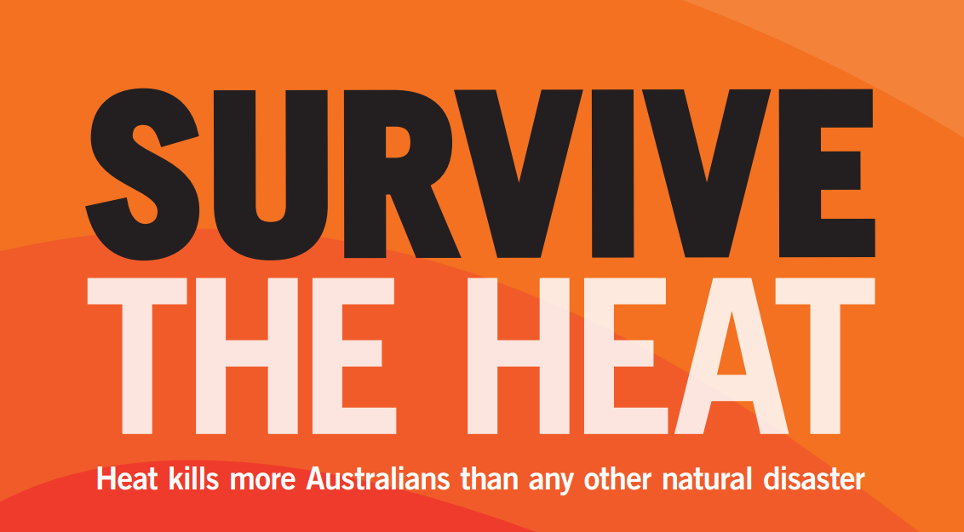
Heat Health
What you need to know about staying safe this summer

Slide 2
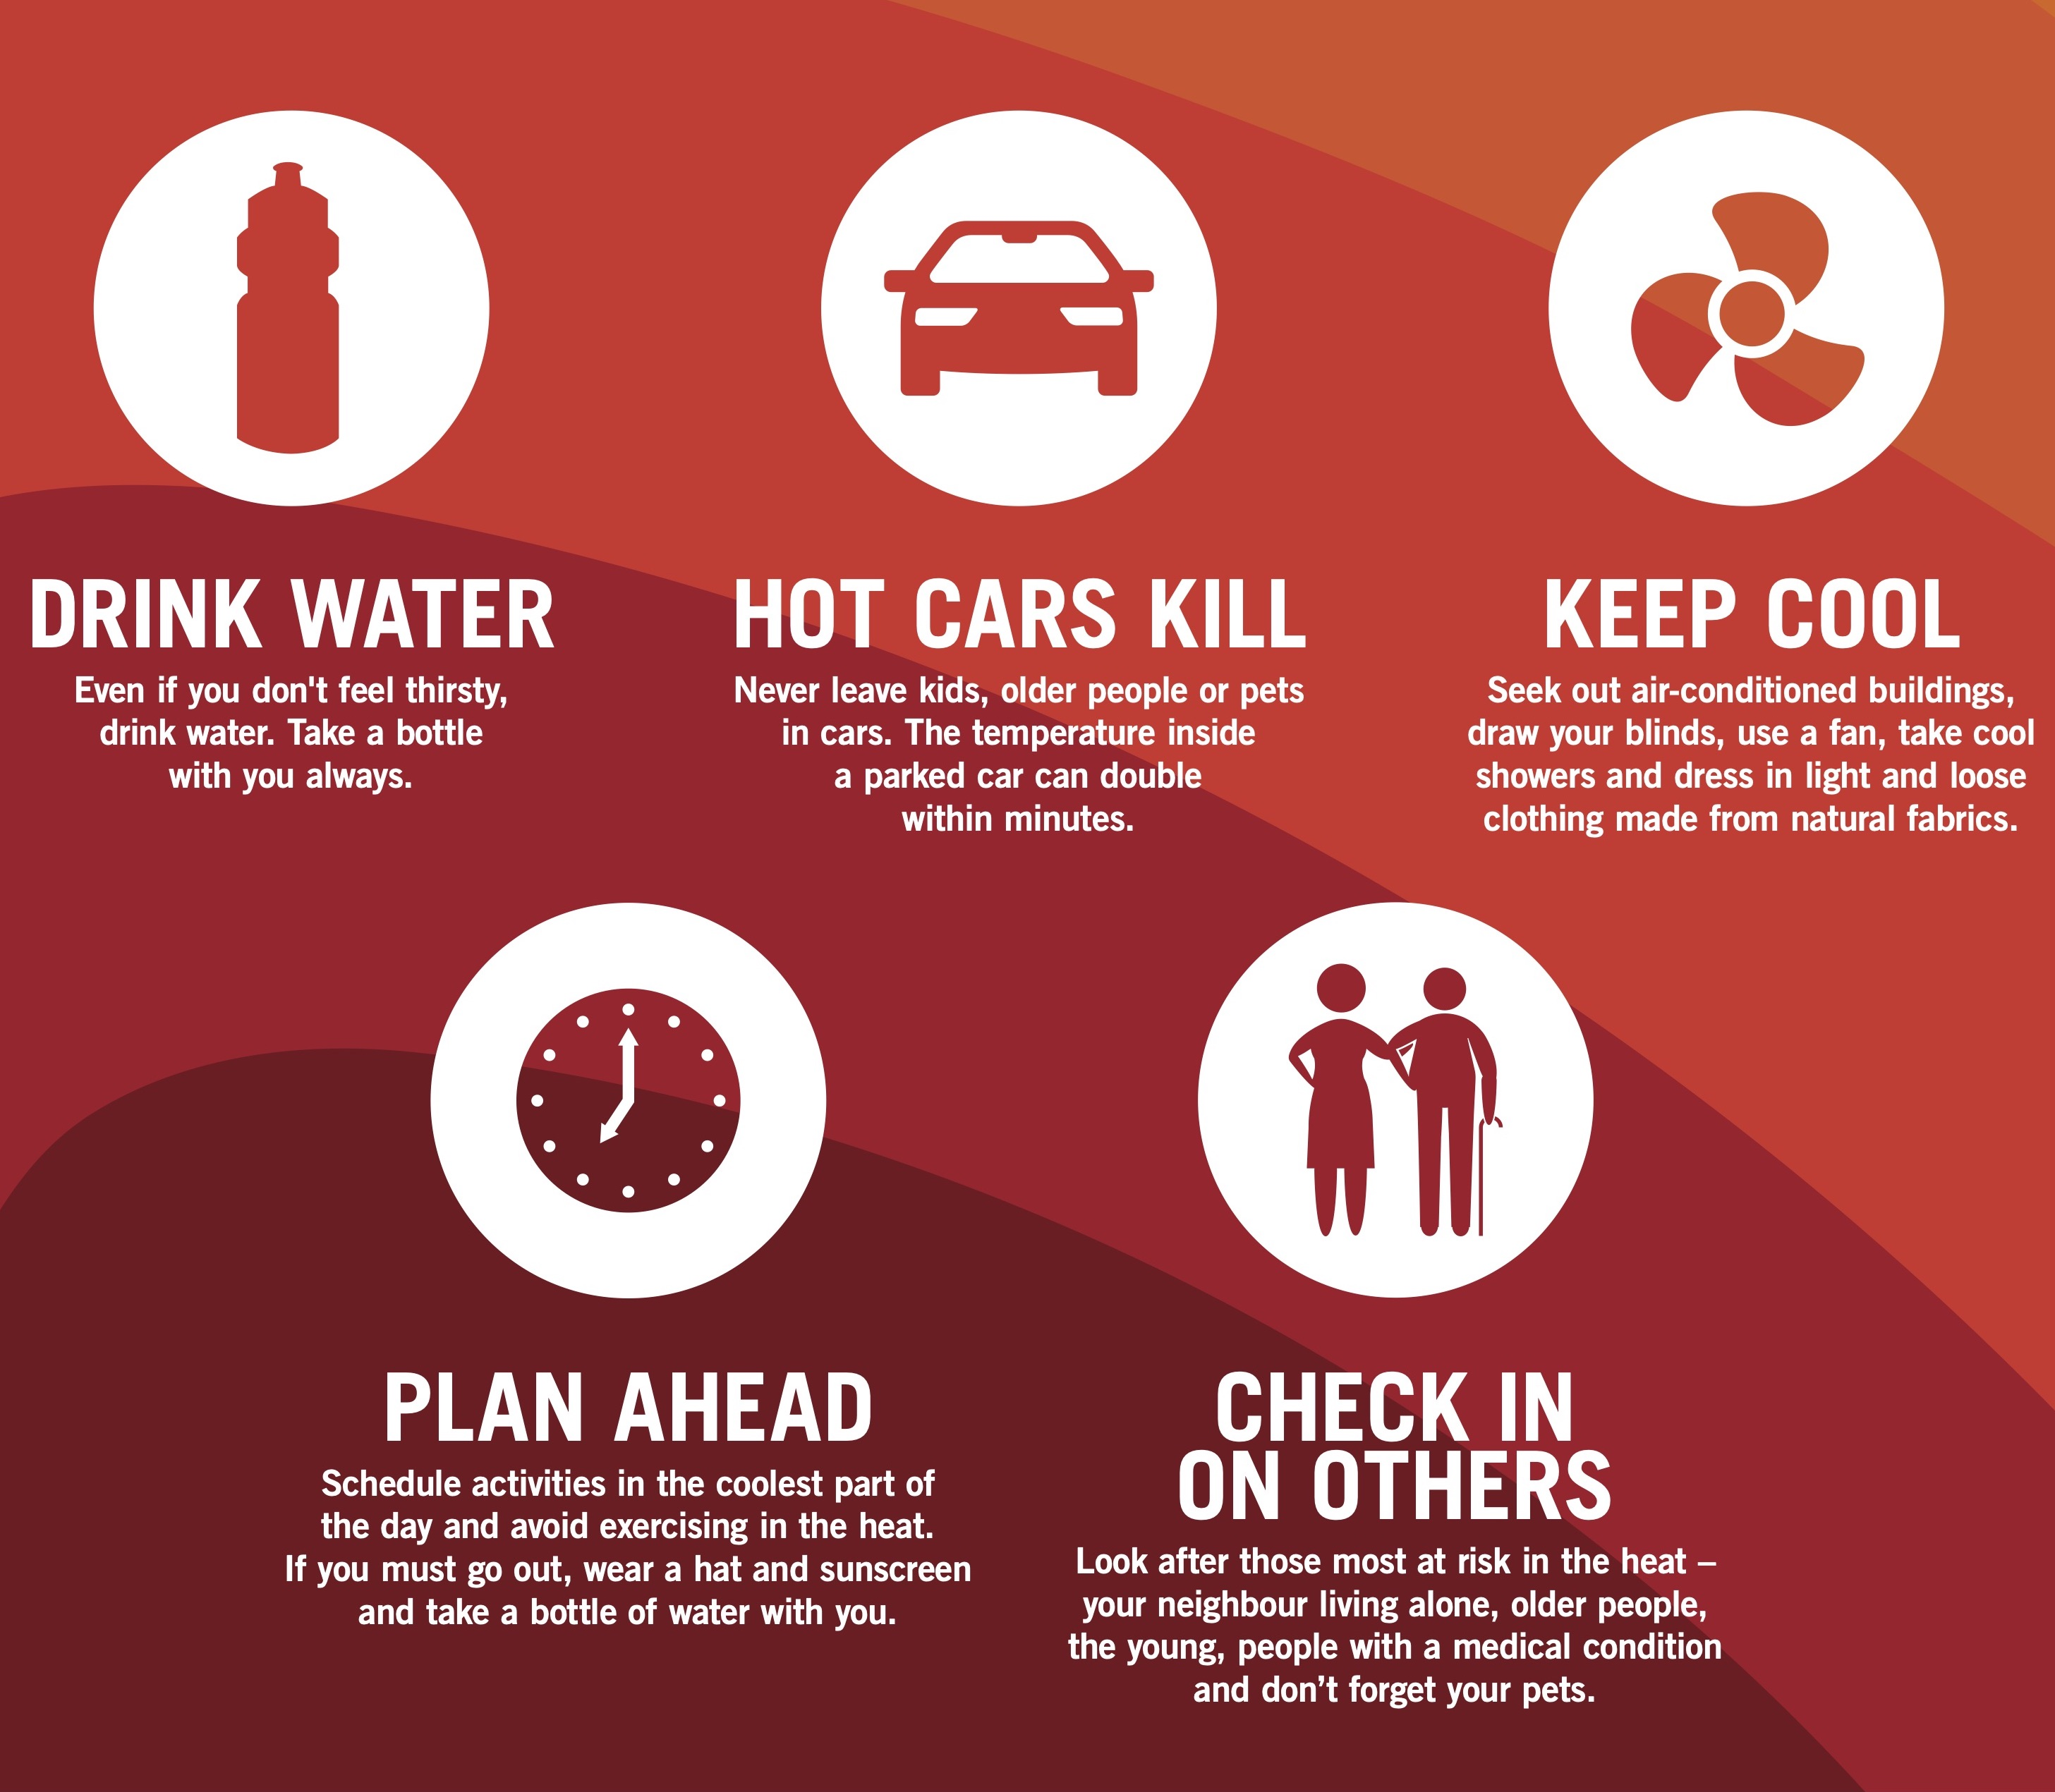
About this community forum:
With the warmer weather approaching us Benalla Health brings to you these messages about staying healthy during the hot weather and heatwaves.
In a heatwave people are more likely to develop a heat-related illness and can become unwell much faster than usual.

Slide 3
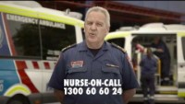
Video Found here Extreme heat - what to do to survive the heat - YouTube

Slide 4
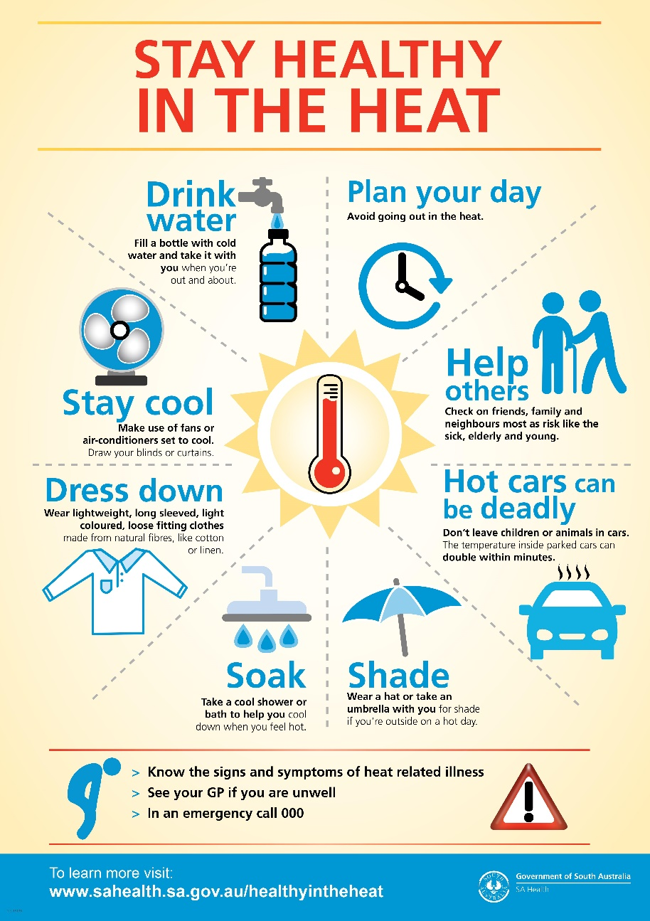
How to stay safe
Handy resource found here - https://tinyurl.com/3s79y6fj

Slide 5
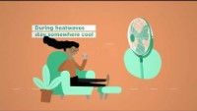
Stay cool in a changing climate
Video found here - Climate change and health – Staying healthy in a changing climate – YouTube

Slide 6
Signs to watch out for:
 | Symptoms | What to do
Heat cramps | Muscle pains Spasms in the abdomen, arms of legs | Stop activity and sit quietly in a cool place. Drink cool water. Rest a few hours before returning to activity. See a doctor if cramps persist
Heat exhaustion | Pale complexion and sweating. Rapid heart rate. Muscle cramps, weakness. Dizziness, headache. Nausea, vomiting. Fainting. | Go to a cool area and lie down. Fan if possible. Drink cool water if not vomiting. Remove outer clothing. Wet skin with cool water or wet cloths. See a doctor
Heat stroke (a life-threatening emergency) | Same symptoms as heat exhaustion except sweating stops. Mental condition worsens, confusion. Seizure. Stroke like symptoms or collapsing. Unconsciousness. | Call an ambulance – phone 000. Get the person to a cool area and lay them down. Remove clothing. Wet skin with water, fanning continuously. Position an unconscious person on their side and clear the airway.

Slide 7
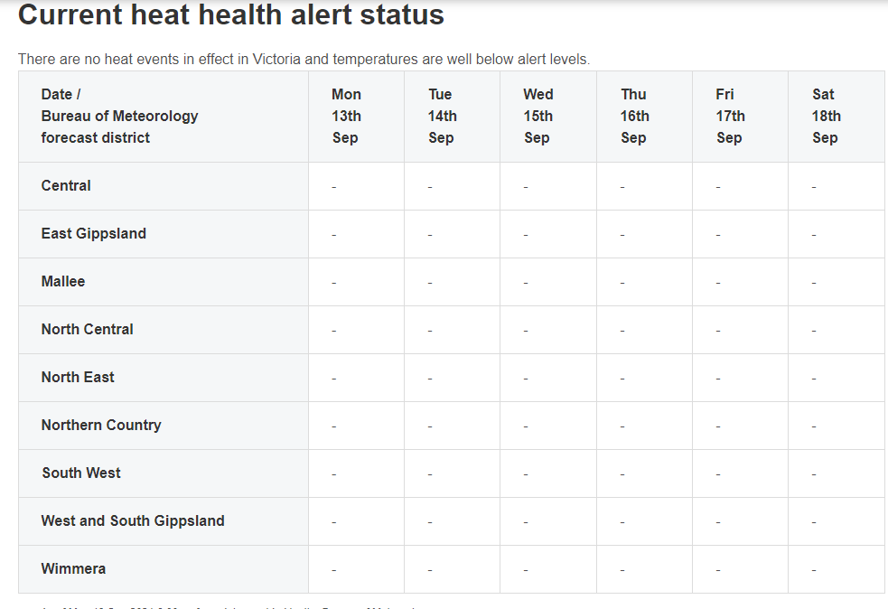
Keep yourself updated –
Heat Health Alerts
To stay up to date with heat health alerts please check with the Department of Health or with the link below.
Current heat alerts - Heat health alert status - health.vic

Slide 8
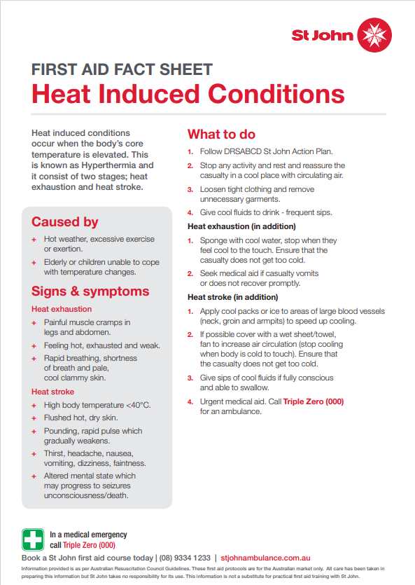
What to do:
Handy resource:
heat-induced-conditions.pdf (stjohnwa.com.au)

Slide 9
Looking after yourself
It’s also important to look out for your own welfare in the hotter weather:
Take a break - allow yourself to take ‘time out’ if you find your stress levels rising. This could be a walk, going out for a coffee or listening to music - whatever will help you to relax or unwind. Take some time for Mindfulness, remember to be self compassionate and cut yourself some slack
You could talk to:
  Trusted family or friends,
  Your GP
  Professional counsellor
  Lifeline (24/7 telephone crisis support service) 13 11 14
  Beyond Blue 24/7 telephone (1300 224636) or online support (3pm- 12am)
  Get immediate help for depression and anxiety - Beyond Blue

Slide 10
Other issues associated with heat
Bushfires - Link to Vic Emergency and CFA prepare for summer or bushfire
  Am I at Risk? | CFA (Country Fire Authority)
  How to Prepare Your Property | CFA (Country Fire Authority)
  Incidents and Warnings - VicEmergency
Power outages – what to do in a power outage AusNet link and outage map
  Preparing for power outages (ausnetservices.com.au) AusNet Services outage tracker

Slide 11
Thank you
If you have any questions or would like some more information, please don’t hesitate to contact us:
Benalla Health, phone (03) 5761 4222
Community Health, phone: (03) 5761 4500

